Slide 1
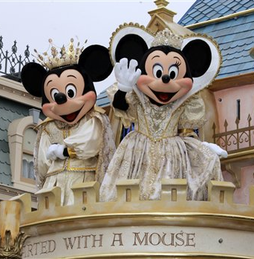
Researching Credible Connections
AP050504022505
Debbie Walker
Student ID 4628379
https://www.diigo.com/list/walker_debbie/WalkerDebbie_RchrhCrdblCnnctnsWk2

Slide 2
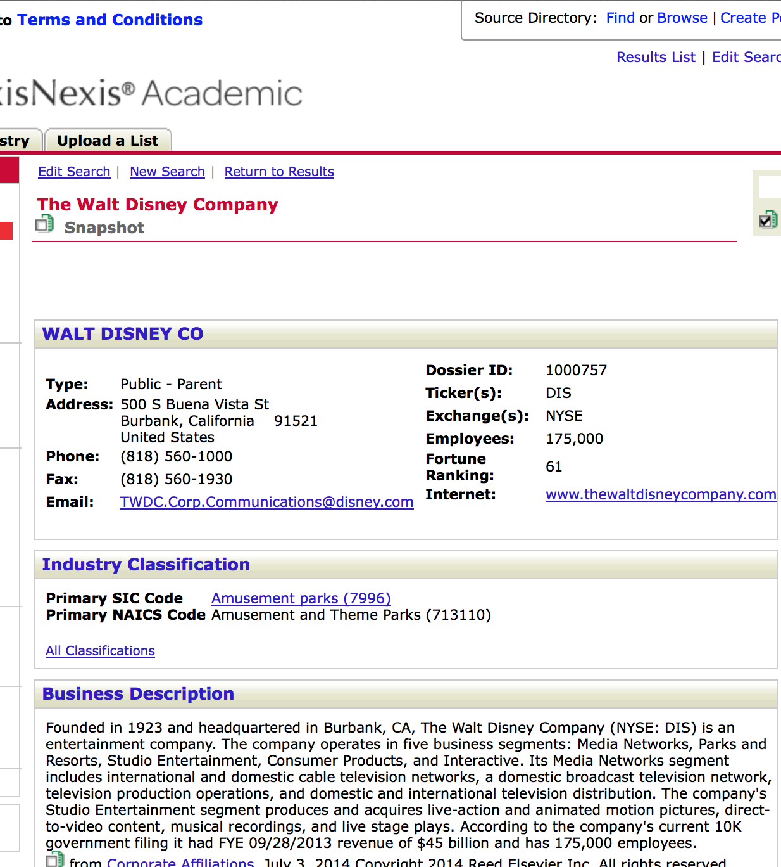
Part 1|Disney
LexisNexis Company Search
Explanation
https://www.diigo.com/list/walker_debbie/WalkerDebbie_RchrhCrdblCnnctnsWk2
http://imgur.com/2oYuE0s
I respect Disney because not only does this company understand the importance of creativity and imagination, but they also understand how to leverage that brand through multi-channel operations for increased revenue during a volatile economic time.
I started really watching this company a few years ago when Jim Crammer did a deep dive on the company’s strategies for revenue growth, or what companies call a 3-5 year strategy plan.
This wonderful place that most children in the United States know because they went home from the hospital in a Disney licensed car seat, watched Finding Nemo in their Toy Story pajamas and dreamed of the day they could go to Disney, has now expanded its opportunities for more fun with family cruise ships, Star Wars, and NetFlix.
I took Jim’s advise and purchased Disney two and a half years ago, as of today my stock has yielded a 157% return on investment. That’s one reason I love Disney.
They had me at long-term growth… https://diigo.com/020wbb

Slide 3
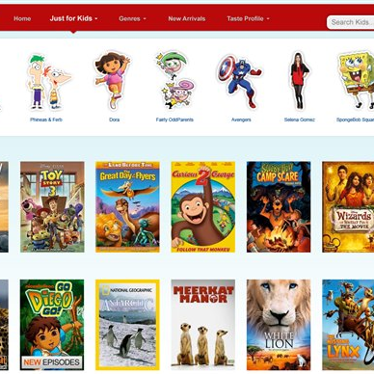
Part 2
AP110816124025

Slide 4
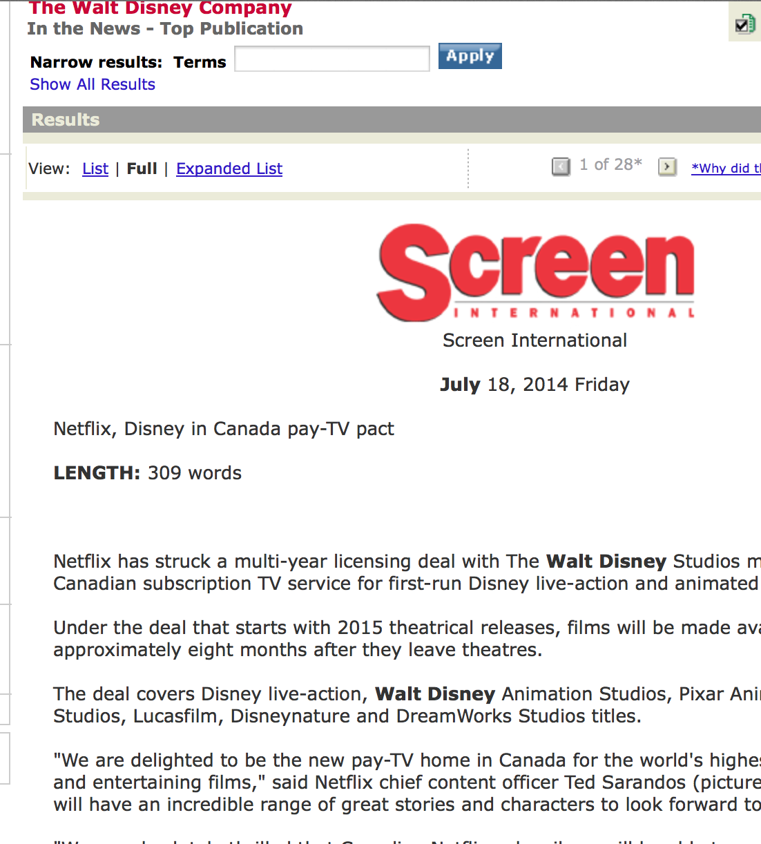
Part 2|Disney
LexisNexis Company Search
Critique
https://www.diigo.com/list/walker_debbie/WalkerDebbie_RchrhCrdblCnnctnsWk2
http://imgur.com/SEqwCVo
The magazine Screen International’s article “Netflix, Disney in Canada Pay-Tv Pact” was authored by Jeremy Kay on July 18, 2014. It did not have a title or job description but rather a personal gmail link. Lack of company name in the email address made me wonder if he is only a freelance writer, so I did further research to see if he had other publications.
Because this is a very current even, there were no revision dates posted of yet. Because I had never heard of this publication I did further research to see if it has a solid standing. I found out that the magazine has a long standing in the film industry dating back to 1975 with it’s sister website publication Sreendaily.com coming on in 2001. Jeremy also writes for that publication, as well.
The article was written without bias opinion or influence from the author. He did a good job sourcing from both Netflix and Disney. He did not list his references, but he did give credit with quotations. He also did not incorporate any links to verify his sources.
The article was 309 words long, but did not seem that long because he was able to keep me engaged. The format was clean and easy to navigate as well. I was a nice break from all the flashing advertisements you get when reading on-line articles. The article was copyrighted 2014 Emap Ltd All Rights Reserved.
In conclusion I found this article to be credible. Not only was it posted through NexisLexis, but the author checked out when I found more than one of his published works and was able to compare the consistency of his writing.

Slide 5
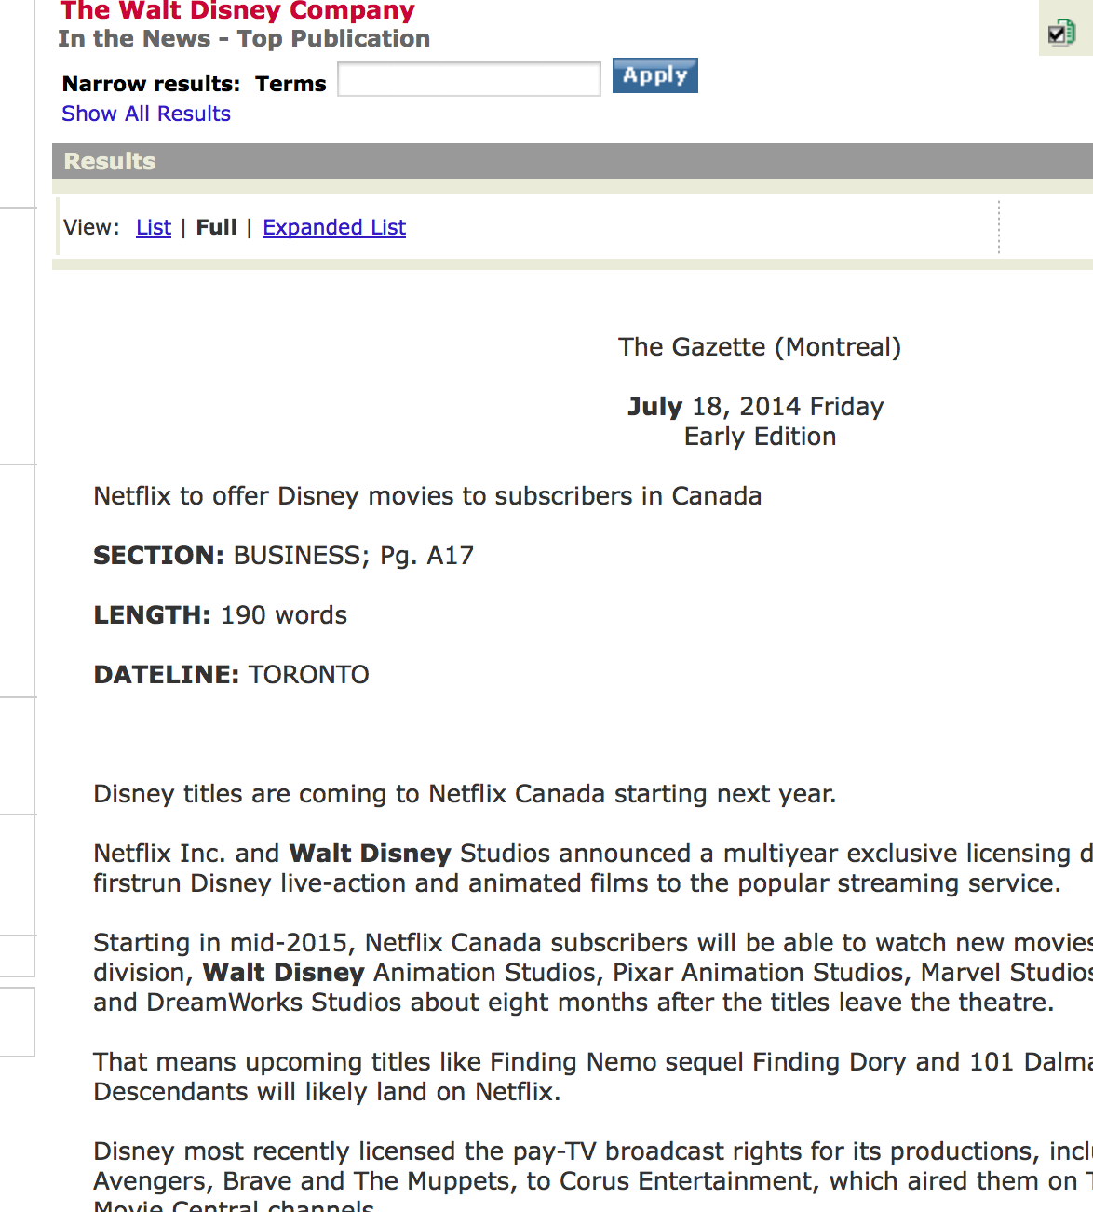
Part 2|Disney
LexisNexis Article 1
Critique
https://www.diigo.com/list/walker_debbie/WalkerDebbie_RchrhCrdblCnnctnsWk2
http://imgur.com/6c4WSJZ
The newspaper The Gazette’s (Montreal) published an article on July 18 2014 titled “Netflix to offer Disney movies to subscribers in Canada.” There was not an author listed for this 190 word article so I figure it was probably a public relations press release. After further investigation, I was able to validate that in deed that is what it was, using the search tool included in this weeks lesson plan I was able to do a quick search to validate this hunch. The search technique I found helpful was related:.
In contrast to Screen International's article The Gazette article has more stringent word count criteria, because this article only focused on the bare bone information, which were highlights. The editor or ghost writer did not take the time to source either company which left the article flat and less credible.
Since the article was not sourced or cited, The Gazette may feel that the facts were presented by the press release so there was no need to quote or cite, and may have assumed that their viewership already had brand confidence in their reporting ethics.
The article was copyrighted 2014 The Gazette, a division of CanWest Media Works Publication, Inc. All Rights Reserved. I decided to investigate CanWest Media Works Publications and found that LexisNexis has them listed but there are no articles what so ever on the company, so then I decided to do a search on the web. I found out that this company claimed bankruptcy in 2009.
In conclusion, even though the facts were accurate and this was pulled from LexisNexis, I would not use this article as a reliable source since there was no way of tracing any of the information.

Slide 6

Part 3
AP13093299211

Slide 7
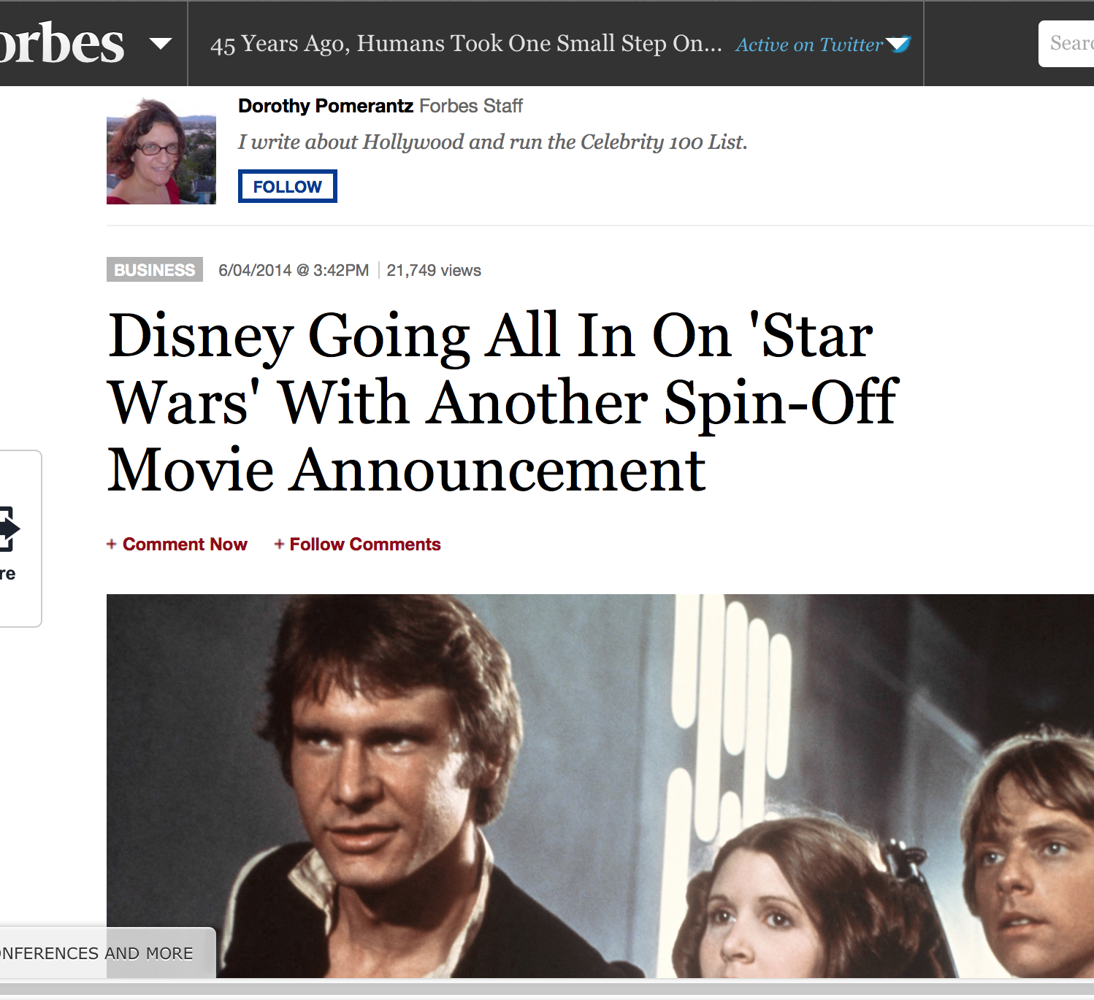
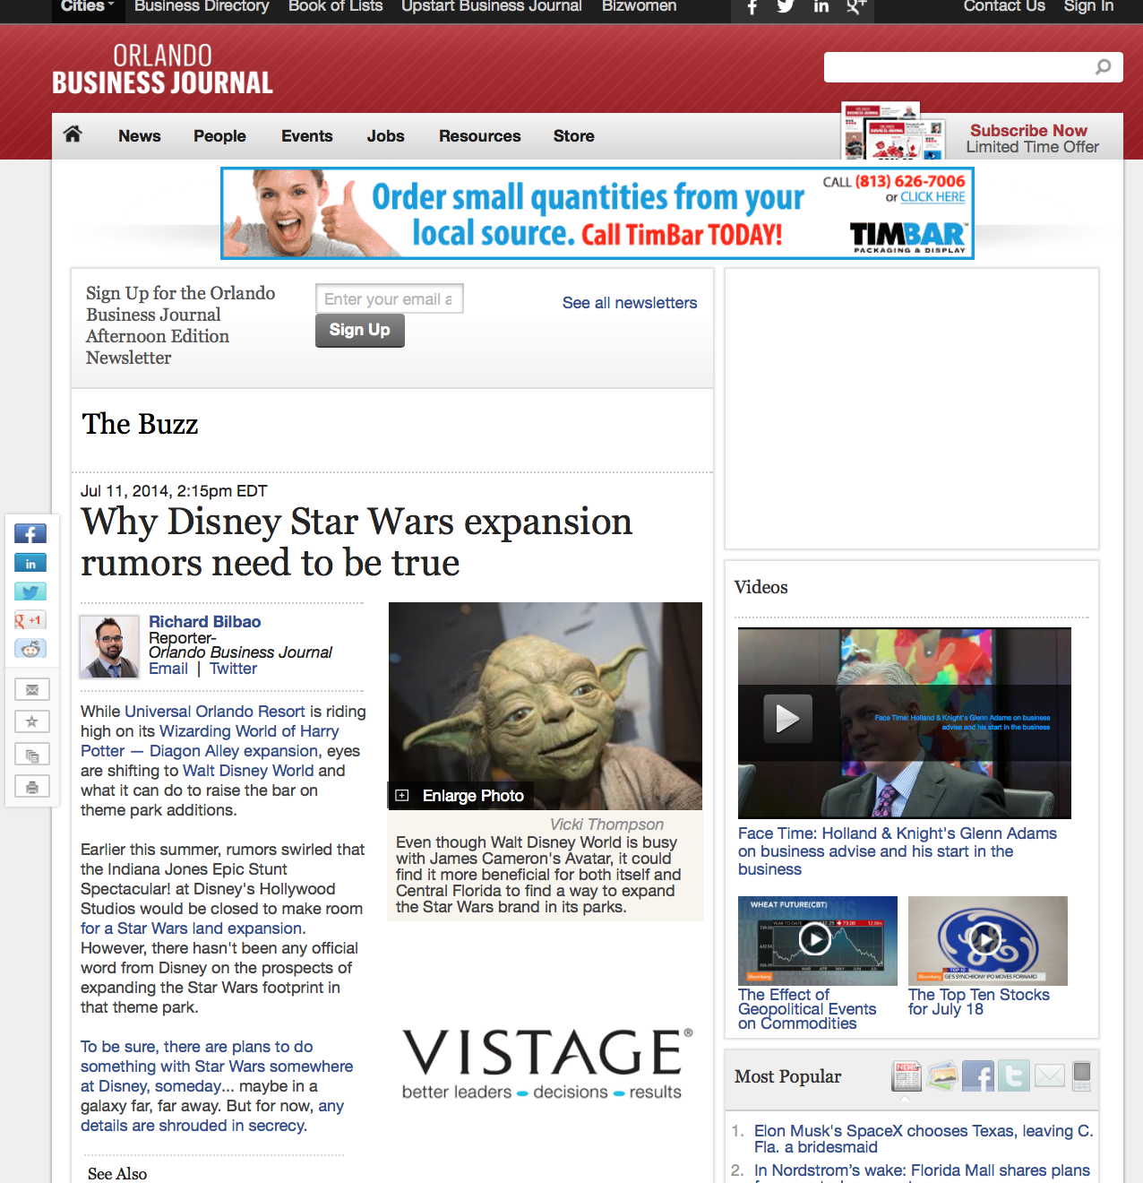
Part 3|Disney
Critique
https://www.diigo.com/list/walker_debbie/WalkerDebbie_RchrhCrdblCnnctnsWk2
In this article “Disney Going All In On ‘Star Wars’ with Another Spin-off Movie Announcement,” author Dorothy Pomenante, a Forbes staff writer who specializes in writing about Hollywood and while running the “Celebrity 100 List,” writes in movie announcer style.
The article was posted on June 4, 2014 and has already received over 20,000 views. Forbes is a well known name in the business industry, so between those two things I started ready with encouragement that this would be a good article to fit the 10 C’s. However, I was wrong. There were more than a few times that the words she choose could be considered sarcastic. She also reported actual dollar figures and what celebrities are up to, but never quoted or used citations for her sources.
I checked other resources reporting on the topic of Disney and “Star Wars” and there seems to be a lot of discussion about whether Disney can pull the next generation of films off without disappointing the original fan base. Another article I found was from Orlando Journal https://diigo.com/020vul and this article confirms the trepidation in the air as Disney has its hands full of many projects.
The pictures were so large that any “Star Wars” fan surfing the web could not miss them. Surprisingly I was not distracted by all the images on the page because it read like a blog post.
I was not able to find the copyright until I clicked on the Forbes logo and it took me to their home page where it was located; © Forbes.com LLC™ All Rights Reserved.
As it turns out, I would not cite the author from Forbes, but I would the author from Orlando Journal who makes a point of adding buzz to the news but in a responsible way of citing resources with links and sources.

Slide 8
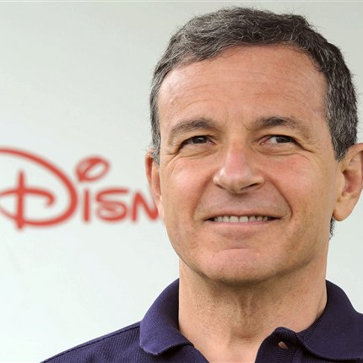
Part 4
AP110612095825

Slide 9
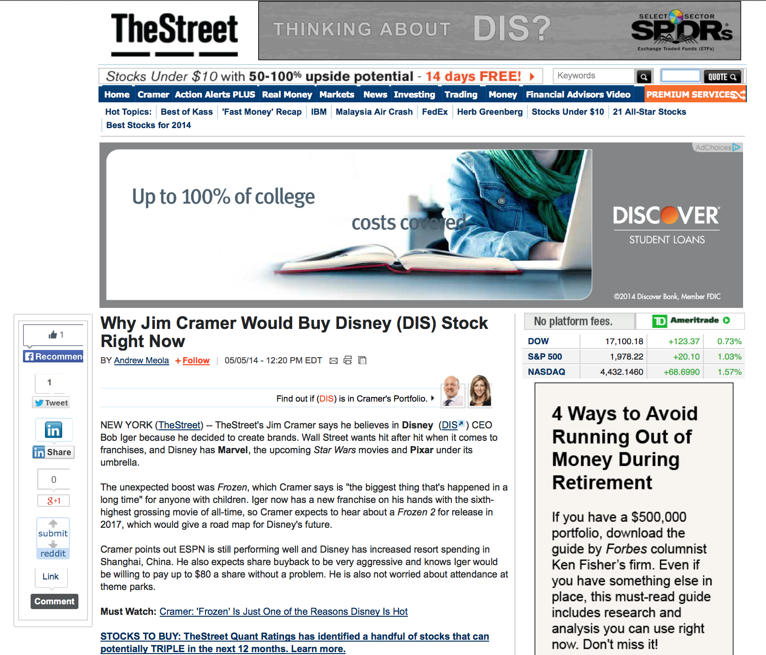
Part 4|Disney
Critique
https://www.diigo.com/list/walker_debbie/WalkerDebbie_RchrhCrdblCnnctnsWk2
“Why Jim Crammer Would Buy Disney (DIS) Stock Right Now” was written by Andrew Meola, last updated 05/05/14, for TheStreet. If you click on Andrew’s name it will take you to his short bio where you will see if credentials and get a sense of his fun personality. This tactic builds trust with readers and adds empathy when or if he makes an error.
Jim Crammer is a host on host on CNBC’s Mad Money, former hedge fund portfolio manager and author who also contributes to TheStreet. Meola writes about “highliights from the analysis” and other reports like the “DIS Rating Report,” which can be downloaded from the site for $9.99. Meola is able to establish credibility by interviewing an industry subject matter expert while providing irrefutable proof through data.
The article boils down to Crammer conceding that “it’s Disney’s time” as it outperforms other major networks, including his own through constant success with its brand into a multitude of other foreseeable opportunities, like “Star Wars.” TheStreet’s rating team also gave Disney an A+ based on its financial investment measures in spite of the low profit margins
Meola includes hyperlinks in his article, some back up claims with reports, but a few of the links connect you to an annoying advertisements for software. This cheapen the information, and distracts from the reading.
The links to sources confirm that Meola is accurate with is information and could be trusted to use as a credible resource. TheStreet has an ethical reputation and even puts is claims on the internet in order to maintain transparency. The article was copyrighted in © 2014 TheStreet, Inc. All rights reserved. Made in NYC, Mobile Version. Over all the technique that Meola used was successful in giving credit to his story and concept of the title.
I feel comfortable referencing the information about Disney from this article because I could not find any reason not to.

